Slide 1
LFSR Visualization Aid

Slide 2
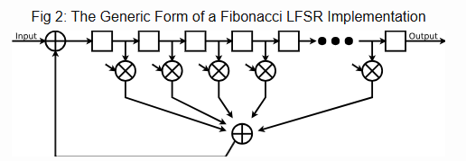
Lab 5 conceptual diagram
I found this diagram that might be helpful.
Note: Set input to 0, ignore output.
X are logical AND
+ is logical XOR
Arrows into ANDs are feedback/tap pattern polynomial
For N=3, enable first two AND gates (mask bit = 1) and disable the rest (mask bit = 0)

